Slide 1
Learning Management System
Team Members: Johnathon Thomas, Aaron Raoofi, Savorn Sam, Emmanuel Ogunkoya, Chris Kania

Slide 2
Team Model
Combination of Democratic Team Approach and Classical Chief Programmer Team Approach
Kania, Christopher: Lead Programmer for Login Page, Administration Page, Student Page, Graphical User Interface designer, Programmer and Artifact Contributor
Ogunkoya, Emmanuel: Administrator view, UML developer and Artifact-Contributer.
Raoofi, Aaron: Team Lead, Artifact-Contributor, Student view, Administrator Functions, Programmer
Savorn, Sam: Database Design and Database Engineer, Programmer, Artifact-Contributer
Thomas, Jonathan: Artifact-Lead and Contributor

Slide 3
Github Content
https://github.com/uhdsoftwareengineering/Project-Documentation-Research

Slide 4
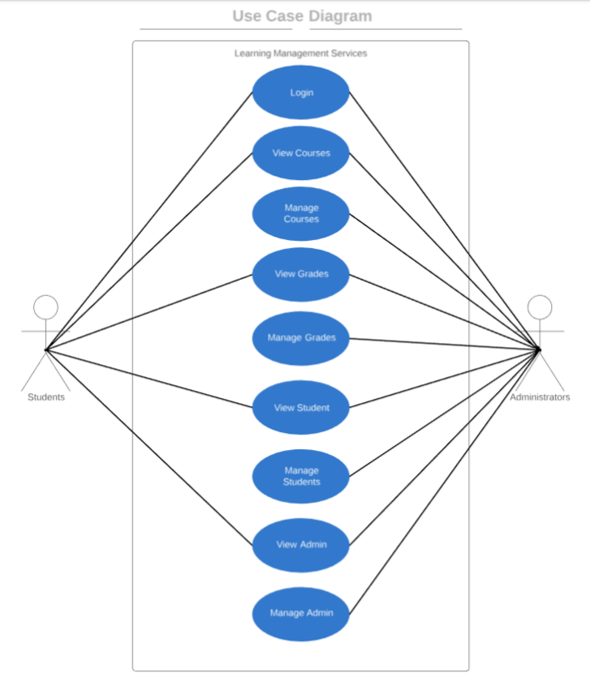
Use-Case Diagram

Slide 5
Software Project Management Plan
Open in Word

Slide 6
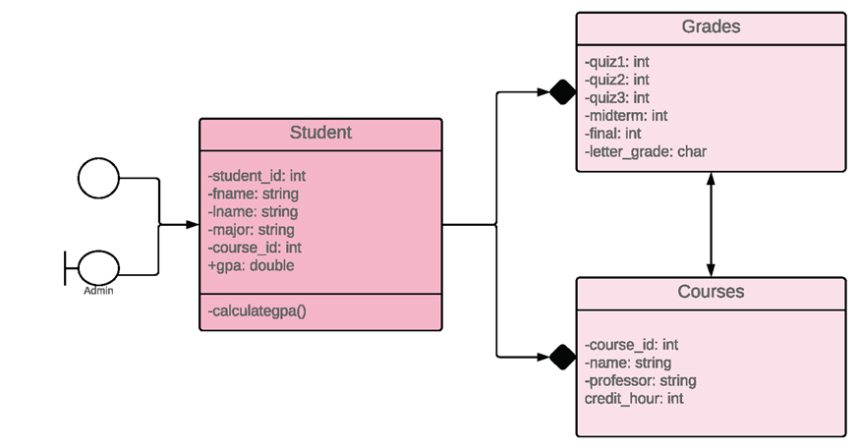
UML Diagram

Slide 7
Class Diagram E/R Diagram

Slide 8
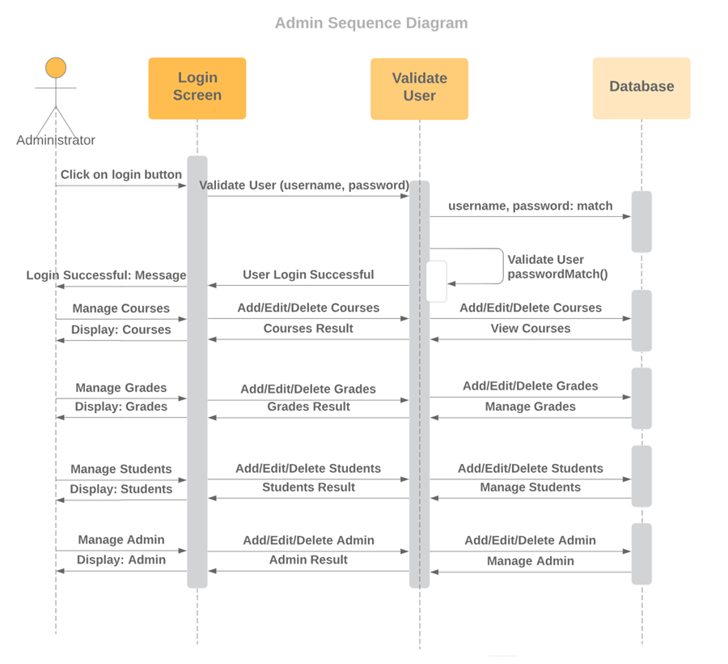
Sequence Diagram -Admin

Slide 9
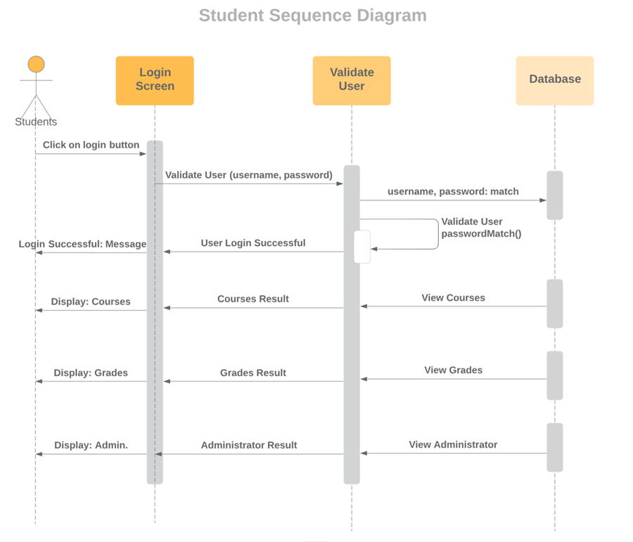
Sequence Diagram -Student

Slide 10
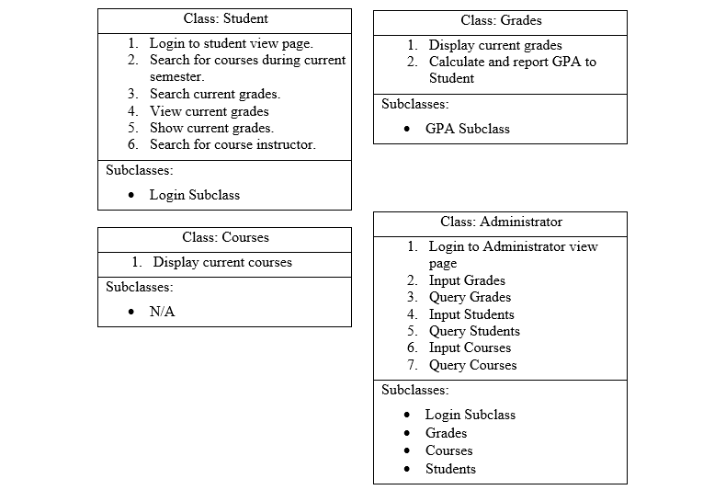
CRC Cards

Slide 11
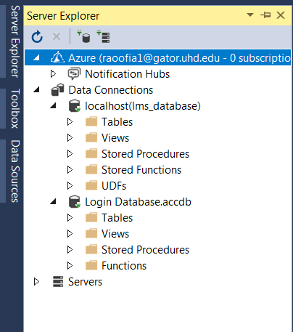
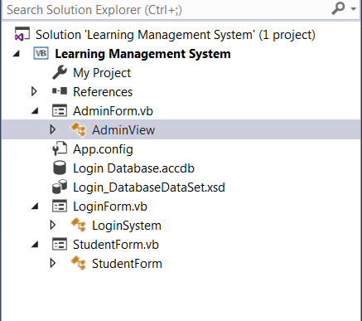
Testing
Unit Testing and Integration Test was carried out by Chris Kania and Aaron Raoofi.

Slide 12
Source Codes
Open Visual Studio

